Slide 1
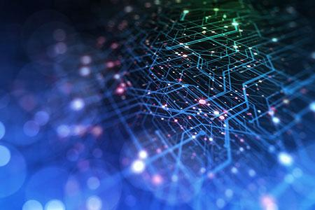
Model Session 1&2 Report
About 16 participants
Notes:
Thanks for the introduction
Thanks to the organizers for the invitation to give a keynote
Of course, I would like also to thank all the collaborators and students, postdocs and researchers who collaborated with me.
Don’t count, there are more than 450 ;-)
You know it already; it is extremely hard to succeed alone in research. So, I took the easy way: I collaborated with many talented researchers.
I would like to thank all of them for sharing some of their time and for all the discussions we had.

Slide 2
Model Architecture and Performance Evaluation
We separated into 4 groups
Pretraining: 6 people
Inference: 3 people
Micro-benchmarks: 2 people
Vision Transformer: 2 people

Slide 3
Pretraining
System: Stampede
Framework: Huggingface Transformers
Model: Llama2-7B LoRA
Data: Alpaca-cleaned
Performance: Full 130 TFlop/s per tile
Multiple node not working (Intel MPI and HF trainer problem)

Slide 4
Inference
System: Sophia
Framework: vLLM
Model: Llama3.2
Data: Random prompts (dummy data)
Performance: Provide plots

Slide 5
Micro-benchmarks (discussion)
Defining base and peak performance
Apples to apples comparison between different GPUs
Comparison between specialized hardware
Stressing all parts of the network (intra,inter-node)
SC24 BoF: "The future of benchmarks in supercomputing", "MLPerf"
Hardware specific optimizations
https://github.com/argonne-lcf/ml_communications/tree/main

Slide 6
Vision Transformer
System: Sunspot, Polaris
Framework: Megatron-DeepSpeed
Model: Vision Transformer
Data: CIFAR10
Performance: Provide plots
Sunspot: 410 TFlop/s (4 PVC tiles), BS 256 per tile
Polaris: 710 TFlop/s (4 A100), BS 256 per GPU
Memory: 32GB for both Sunspot and Polaris

Slide 7
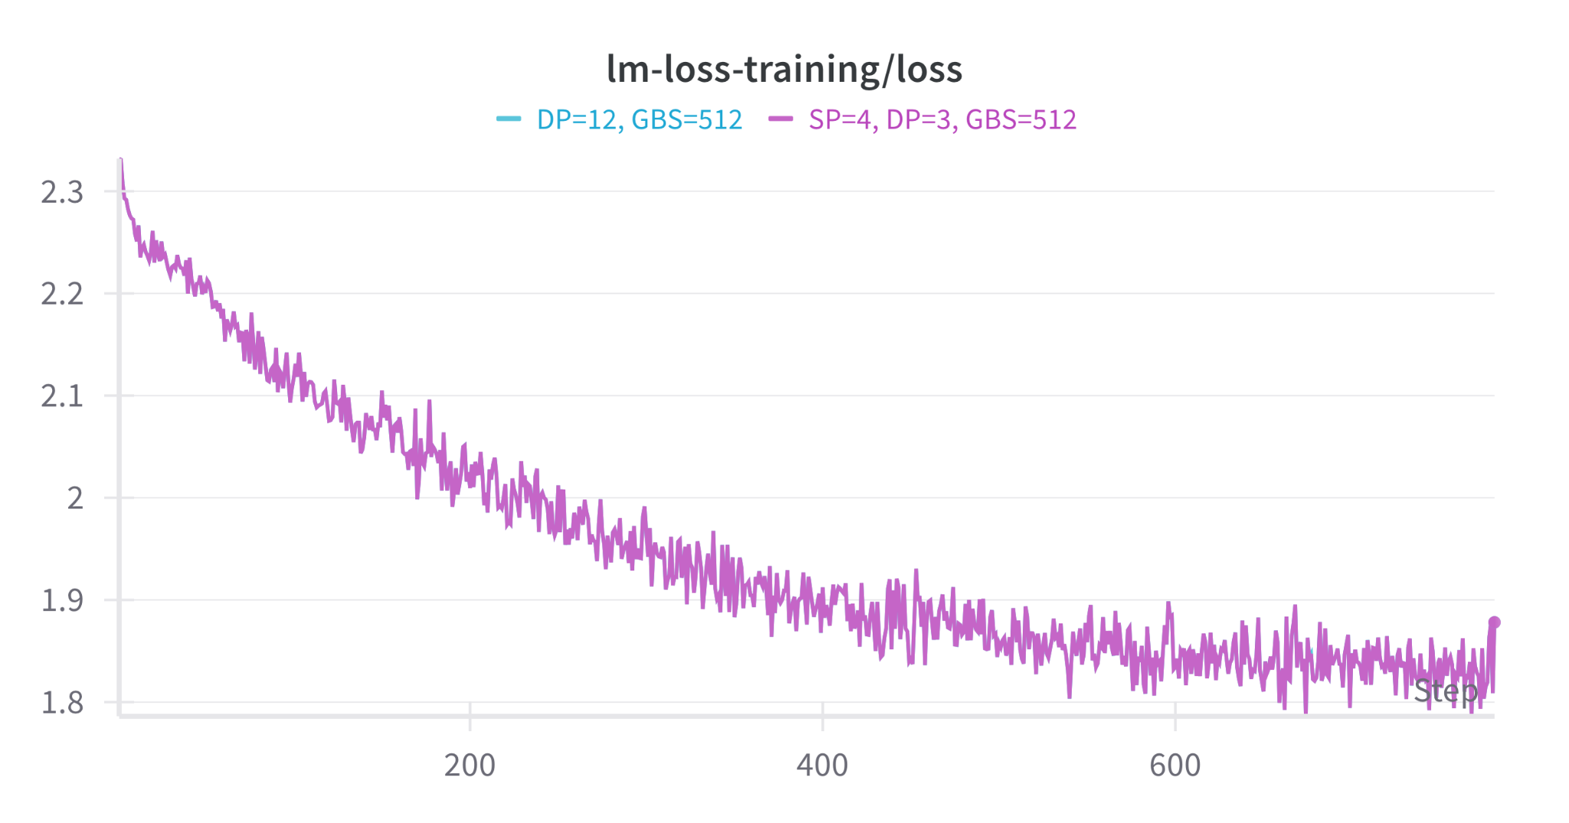
Vision Transformer

